Slide 1
Testing biomarkers in Cerebrospinal Fluid (CSF) where are we?
Maria E. Arcila MD
Memorial Sloan Kettering Cancer Center, New York, NY, USA

Slide 2
Disclosures
Not directly relevant to the content of this lecture
Company | Relationship(s)
Janssen Global Services, Bristol-Myers Squibb, AstraZeneca, Roche, Merck, Biocartis | Consulting

Slide 3
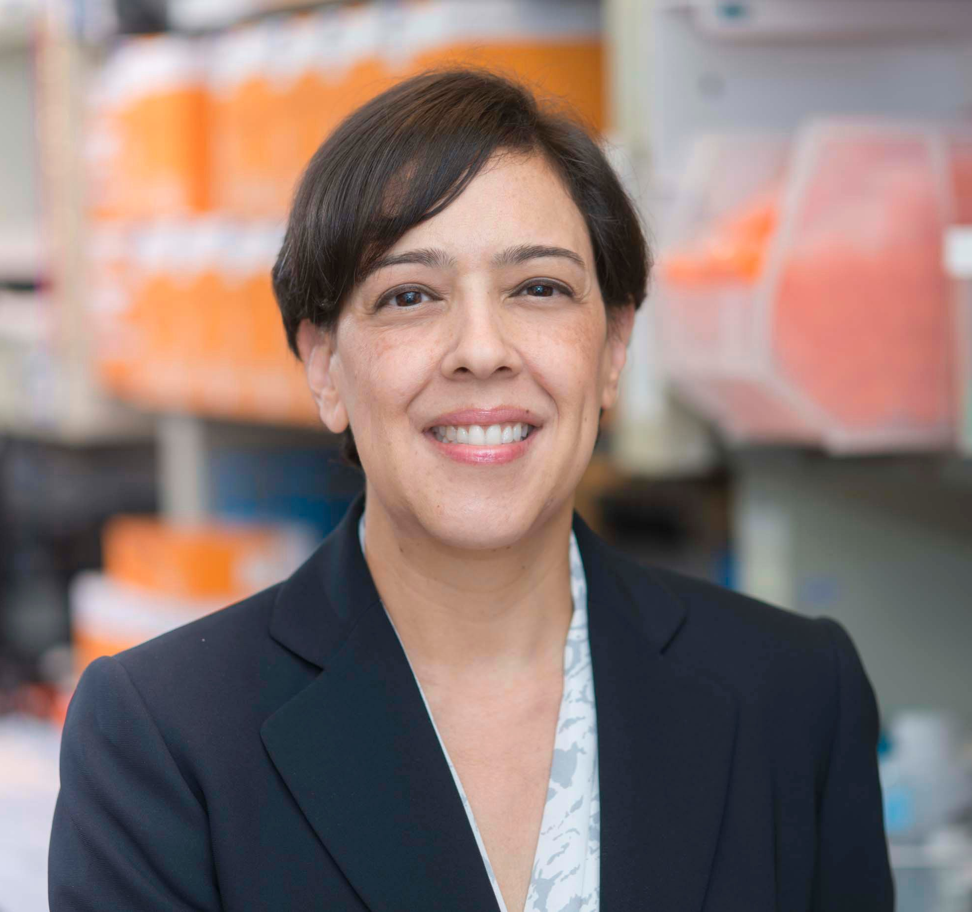
Maria E. Arcila, M.D.
Attending
Molecular Diagnostics and Hematopathology Services
Laboratory Director, Diagnostic Molecular Pathology
Department of Pathology and Laboratory Medicine
Memorial Sloan Kettering Cancer Center
You can find me at:
@MArcila

Slide 4
Objectives
Objective
Describe the utility of CSF for tumor molecular profiling
1
Objective 2
2
Recognize unique opportunities and potential limitations of cfDNA to detect genetic alterations
Objective 3
3
Describe some pre-analytical aspects of utility for implementation
Notes:
In this talk we are going to do a review of basic genomic technology
Review techniques to enable targeted cancer therapies
Describe various sources, fragmentation, and clinical utility of cfDNA.
Recognize unique cfDNA analytes that may be detected in cfDNA
Summarize key limitations and opportunities of cfDNA across different sources

Slide 5
Genomic characterization of tumor tissue is a pivotal component for the diagnostic and therapeutic management of CNS malignancies
Tumors may be primary or metastatic
Distinctly challenging to diagnose and monitor
Notes:
Genomic characterization of tumor tissue is a pivotal component for the diagnostic and therapeutic management of CNS malignancies. Both primary and metastatic tumors may affect the central nervous system (CNS) and are distinctly challenging to diagnose and monitor
Importantly while the incidence of primary and metastatic brain tumor is increasing. Metastatic lesions are much more common and increasing at a faster pace due to advances in the efficacy of systemic therapy for cancer.
For example, the advent of trastuzumab has dramatically improved survival in human epidermal growth factor receptor 2 (HER2)-positive breast cancer, leading to increasing incidence of brain metastases in patients as they live longer with systemic disease (6). A similar phenomenon has been observed in colorectal cancer; as brain involvement is a late-stage finding, and advances in systemic therapy have improved median survival nearly fourfold, the incidence of brain metastases has increased (7).

Slide 6
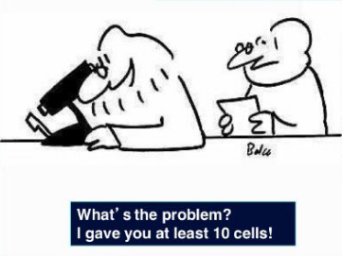
In surgical pathology tissue is always the issue
Embracing the minimally invasive approach
Can you do all testing based on my single diminutive biopsy
Can you laser micro-dissect to select the single tumor cell you see in this field
What do you mean you have to make a diagnosis first before you send for molecular testing
Can you test for 100+ markers by tomorrow

Slide 7
Distinct barriers of tumor tissue diagnosis
Location
Risky procedures, may not be feasible
Limited material
Not amenable to multiple,
extensive or serial sampling
Infiltration pattern
Inherent invasive and highly infiltrative nature
Intimately associated with normal tissue
High disease recurrence rate
Blood brain barrier
Highly protected environment
Complex features of clonal tumor evolution and unique and local resistance mechanisms -
Evasion and modification
Establishes complex networks with their own microenvironment
High biological heterogeneity – intertumoral, intra-tumoral
Notes:
There are, however, numerous barriers to tumor diagnosis – this relates 1 to the location of tumors – biopsying involves risky procedures where large samples may not be obtained and there is little opportunity for serial sampling.
If tumor s are primary, they are highly infiltrative and intimately associated with normal tissue – it is difficult to biopsy only tumor and difficult to remove the rumor = leading to high disease recurrence. Tumors also establish complex networks with their own microenvironment – leading to highly heterogeneous tumors that have different molecular composition from site to site – making it difficult to establish the genetic attributes of the tumor as a whole.
Finally, there is the issue of a blood brain barrier – this promotes a highly protective environment for brain tumors, where they can develop unique genetic attributes, clonal tumor evolution and local resistance mechanisms that are also difficult to sample with single small tissue biopsies

Slide 8
Cerebrospinal fluid a unique source of cfDNA

Slide 9
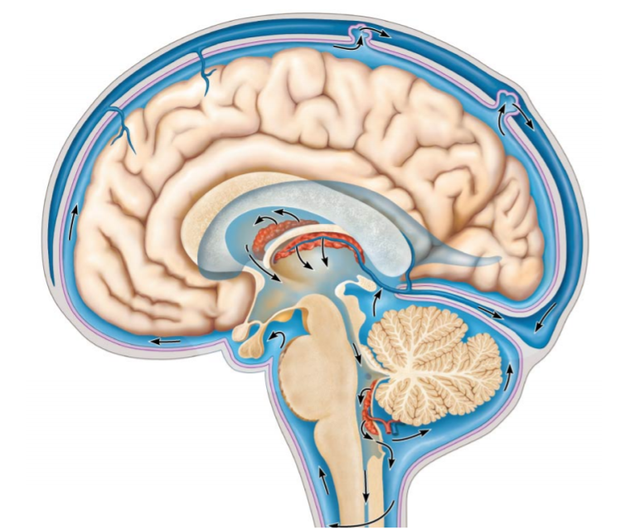
Unique opportunities – Cerebrospinal fluid (CSF)
Circulating Tumor DNA, RNA (mRNA), proteins
Circulating Normal DNA, RNA (mRNA), proteins
Tumor
Fluid circulates in a closed system
Protected by the blood brain barrier
Notes:
The CSF provides unique opportunities as an alternate source of tumor genomic material. Briefly, the CSF is the fluid that encases and circulates constantly around the CNS, fully protected by the blood brain barrier. Any tumor affecting the CNS may gain access to this fluid – spilling whole tumor cells into the space or free fragments of genetic material. By sampling the fluid one can sample tumor DNA from various locations capturing the genetic heterogeneity of all locations affected. Due to the absence of blood cells as one would see in the blood, cfDNA from CSF constitutes a pure source of DNA from the CNS not contaminated by hematopoietic sources.

Slide 10
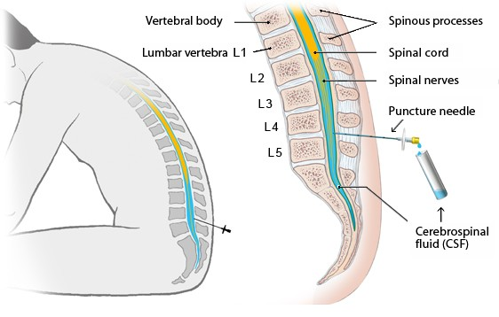
Routine lumbar punctures
Historically:
Low yield
Often false negative
Largely Insufficient for molecular studies
X
Notes:
Historically in fact, Routine lumbar punctures have long been a standard of care in patients with tumors affecting the CNS. After sampling through a lumbar puncture the fluid is centrifuged and separated into 2 components – a cell pellet which is used for morphologic assessment and the fluid generally discarded

Slide 11
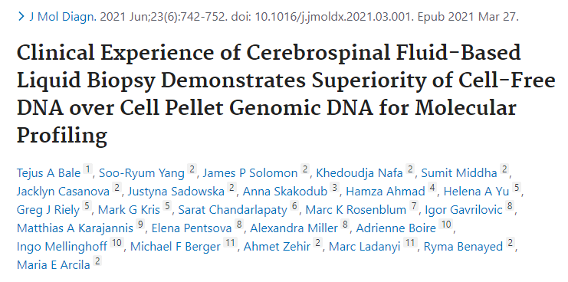
Validated and approved as a CLIA grade assay through NYSDOH
Currently the only assay clinically validated for molecular diagnosis of cfDNA from CSF
Fluid
cfDNA from CSF
Comprehensive Next generation sequencing by MSK-IMPACT
505 genes
X
gDNA from tumor cells
Pellet
Paradigm changing
Notes:
Since 2021 however, we have been making ample use of the fluid part of CSF to isolate cfDNA and test clinically. We have validated the testing through the rigorous requirements of NYSDOH and the assay is cleared for routine clinical use.
Of note – we started testing both genomic DNA isolated form the tumor cells as well as cfDNA from fluid to find that the cells really provide minimal diagnostic value.

Slide 12
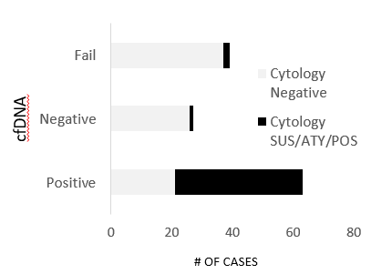
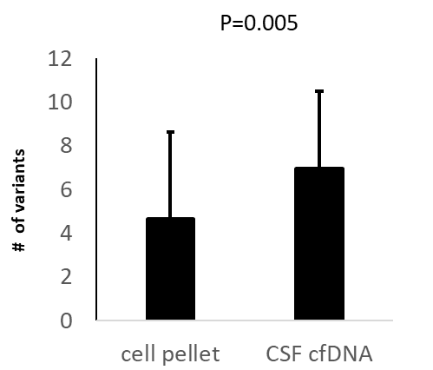
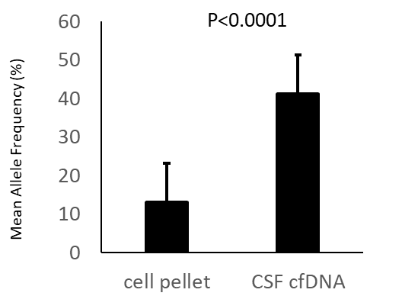
cfDNA sequencing provides more information
than corresponding pellets despite lower DNA yield
Higher VAF’s
Higher variant detection
Mutation positive even in cases that are cytologically negative
1/3 of cases with mutations are negative cytologically
Notes:
In all aspect of our clinical validation we find that sequencing cfDNA provides far more information that the corresponding cell pellets – higher VAF, vriant detection and even for cases negative cytologically – one can identify mutations – about 1/3 of cases with negative cytology harbor mutations that have clinical significance

Slide 13
EML4 ALK lung cancer – with brain mets
Gene | variant | Primary tumor VAF% | Pellet CSF VAF% | cfDNA CSF VAF%
EML4-ALK | Fusion | Present | Rare reads | Present
ALK | L1008P | 0 | 0.6 | 49
ALK | G1269A | 0 | 0.2 | 32.9
ALK | I1171T | 0 | 0 | 38.2
KDMSC | P1046Tfs*10 | 8.5 | 0.5 | 73.5
TP53 | R267Q | 0 | 0.4 | 83.5
LATS1 | M791I | 11.9 | 0 | 62.8
RAD21 | D276N | 0 | 0 | 18.9
ATM | R309T | 0 | 0 | 20.9
EZH2 | D137N | 0 | 0 | 45.1
Notes:
To exemplify this – this is the mutational profile of a tumor biopsy and subsequent CSF sequenced .
This patient has a history of EML4-ALK fusion – at the time of progression the patient is found to have the fusion and multiple resistance mutations in alk as well as others in the profile. Notably the VAF in cfDNA are high over 50% in some cases while not at detectable level in the cell pellet.
Example – primary tumor, pellet and CSF – VF of mutations much higher than both the genomic DNA

Slide 14
Clinical - Sequenced samples n=1421
Notes:
To date we have sequenced nearly 1500 samples

Slide 16
Notes:
Here you can see mutations plotted by the oncoKB level of evidence and corresponding VAF in different tumor types. @ main observations is the very high allelic frequency of the variants observed – many close to a100% due to marked amplification or loss of heterozygosity associated with tumor progression and resistance mechanisms. But even in the absence of OncoKB level of evidence – any mutation can be used as evidence of disease and is usable for monitoring of disease

Slide 18
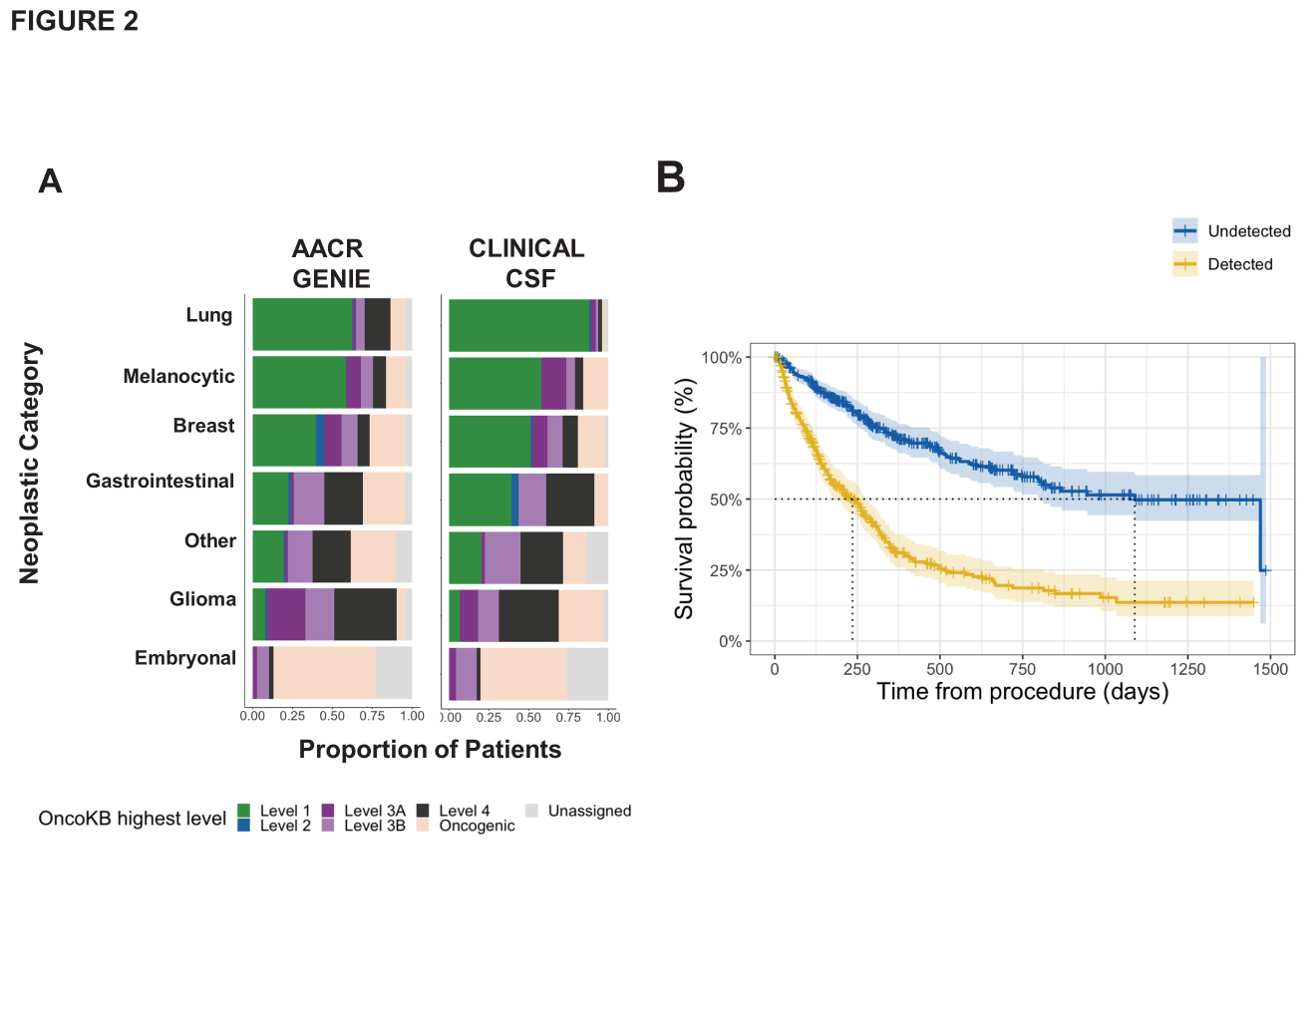
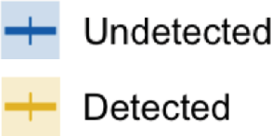
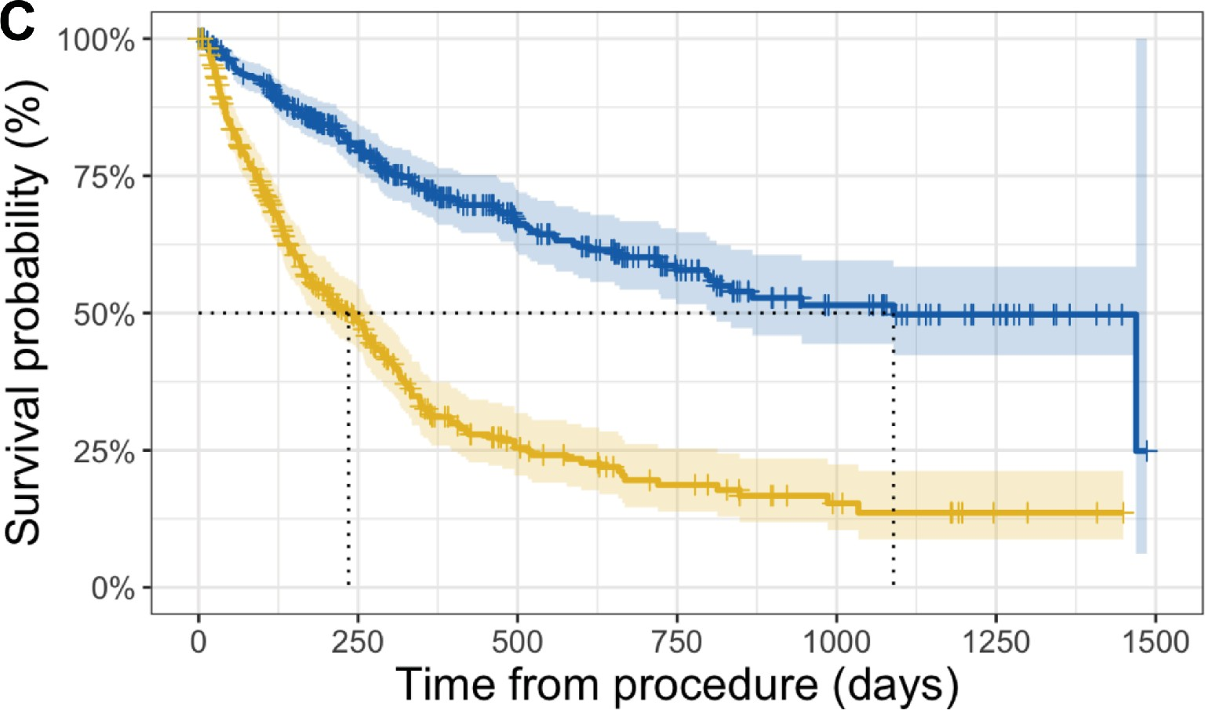
A
AACR GENIE
CLINICAL CSF
Lung
Melanocytic
Breast Gastrointestinal
Other Glioma Embryonal
Proportion of Patients
Neoplastic Category

Slide 19
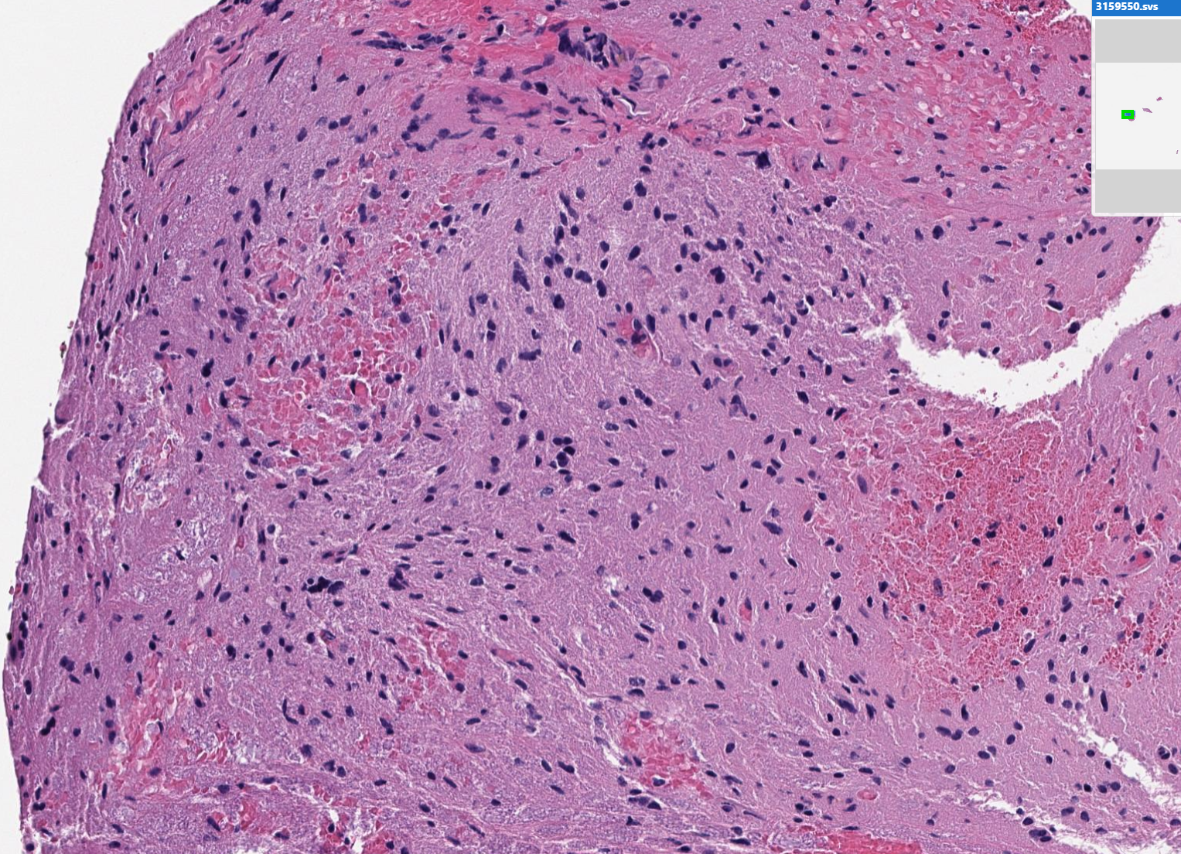
Cell free DNA from fluid
Diagnostic – tumor subclassification
Enabled active monitoring
Documented clonal evolution and increased disease involvement
31yo female with glial tumor
Tumor Insufficient for molecular profiling
Tumor
CSF #1
CSF #2
CSF3
CSF | Cells | None – unsuitable | None – Unsuitable | None – Unsuitable
 | cfDNA | Recovered Low | Recovered Moderate | Recovered Abundant
 |  | 52X | 186X | 436X
Gene | Mutation | Variant frequency %
H3-3A | p.K28M | 6.5 | 11.7 | 79.87
TP53 | p.V216M |  | 1.7 | 85.2
BRCA1 | p.S184F |  |  | 6.8
NBN | p.T148A |  |  | 7.5
NF1 | p.T956Kfs*18 |  |  | 89.7
Notes:
Supplementary Figure 2. Tumor subclassification using CSF-ctDNA (Case Study). A 31-year-old woman presented with an expansile T11-T12 intramedullary cord lesion. Biopsy was submitted for sequencing, but the tissue was insufficient for molecular analysis. CSF-ctDNA identified a histone mutation H3-3A p.K28M which, together with the clinical presentation, supported the diagnosis of diffuse midline glioma (WHO grade IV) according to the 2021 WHO Classification of Tumors of the Central Nervous System. Sequential monitoring by serial CSF sampling demonstrated increasing mutational load and VAF with disease progression. Throughout this time, cytologic assessment of the CSF remained negative.
I should say that many of these cases – despite very low coverage which we would consider technically a failure, we can detect mutations that would gide treatment. In this case for instance – we have a 31 yo female with a difuse midline glioma – the tumor biopsy was unfortunately insufficient for testing and it was the cfDNA, that despite the low coverage provided the mutation information required for classification. Subsequent CSF sampling with much higher coverage supported the increase in disease load – enabled active monitoring and documented clonal evolution.

Slide 20
Diagnosis of unsuspected CNS primary tumor
Papillary thyroid carcinoma (PTC),
Obstructive hydrocephalus/
Total thyroidectomy:
Neck dissection: Metastatic ^{PTC}
brainstem mass (left medulla):
Radioactive Iodine Ablation
pT2N1b
metastasis
Radiotherapy
Chemotherapy
CSF
Deceased 14 months post-
thyroidectomy
44-year- old man
Clonally unrelated tumor
Supports brainstem glioma
gDNA metastatic PTC
CSF ctDNA
BRAF_p.V600E
H3F3B_p.K28I NFI_p.R1204W
NF1_p.T159Lfs*26 NOTCH1_p.G977E RIT1_p.M90V FGFR1_p.N577K PIK3CA_p.H10471
 | 0.24 |  | 0.00
 | 0.00 |  | 0.26
 | 0.00 |  | 0.30
 | 0.00 |  | 0.35
 | 0.00 |  | 0.26
 | 0.00 |  | 0.18
 | 0.00 |  | 0.06
 | 0.00 |  | 0.04
VAF
1.0
0.8
0.6
0.4
0.2
0
Notes:
Supplementary Figure 3. Diagnosis of primary tumor using CSF-ctDNA (Case Study). This 44-year-old man presented to the hospital with a diagnosis of metastatic papillary thyroid carcinoma. Sequencing of genomic DNA from the tumor demonstrated a canonical BRAF p.V600E mutation. In subsequent months, the patient presents with a brain lesion suspected to represent a brain metastasis. CSF sequencing revealed a mutational profile that was distinct from and clonally unrelated to the papillary thyroid cancer, with a non-canonical histone mutation; these variants and the lack of the BRAF mutation indicated a second malignancy (brainstem glioma) for this patient.

Slide 21
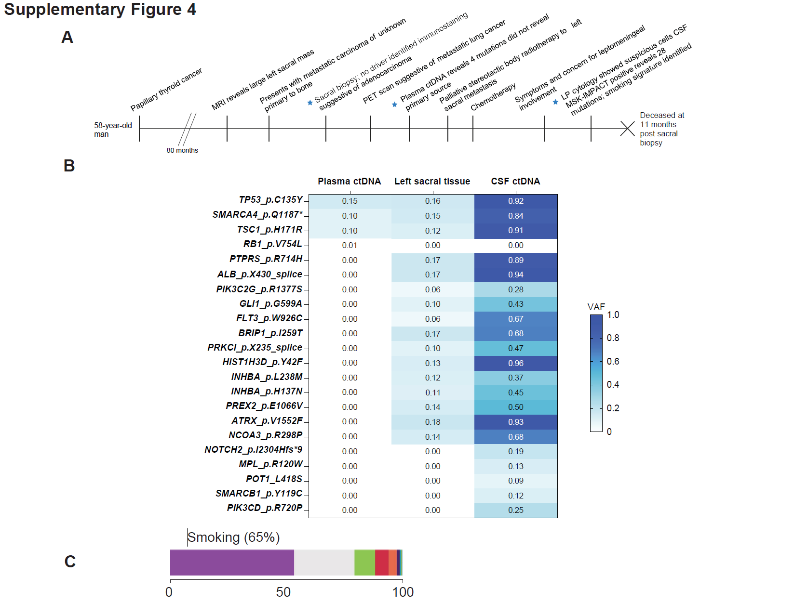
Diagnostic Utility
Defining the primary origin
abundance of C>A, G>T, CC>AA, and GG>TT transversion mutations is suggestive of smoking induced damage mutagenesis.
Notes:
Supplementary Figure 4. Determining clonal relatedness of CNS metastasis to a primary tumor using CSF-ctDNA (Case Study). A 58-year-old man with history of thyroid carcinoma presented a metastatic bone lesion. Histological and immunohistochemical evaluation of the biopsy was non-conclusive, favoring an adenocarcinoma. Plasma testing was initiated and detected 4 mutations with non-specific profile. Sequencing of the sacral lesion did not reveal a driver alteration but pointed toward a metastasis from a lung primary site based on a weak smoking mutational signature. A few months later, the patient developed symptoms concerning for leptomeningeal involvement. Cytology showed rare, atypical cells; CSF-ctDNA identified 28 genetic alterations with high overlap to the sacral tumor profile and with a strong smoking-related mutational signature establishing clonal relatedness between. Together, this data established the diagnosis of metastatic NSCLC to the CNS. A. Outlines the sequence of events. B. Details of the sequencing results in order of availability. Note the marked difference in variant allele frequencies (VAFs) identified in the CSF (higher) compared to the sacral biopsy. The table displays the mutations detected in each sample sequenced, along with the corresponding VAF’s (%), highlighted according to the color scale (right). C. Proportion of the genetic alterations identified in the tumor stratified by the type that would support independent mutational signatures. The estimated tumor mutation burden (TMB) for this sample was 18.1 mutations per megabase (mt/Mb). 65% of the mutations constituted C>A, G>T, CC>AA, and GG>TT transversions, supporting smoking induced damage mutagenesis.

Slide 22
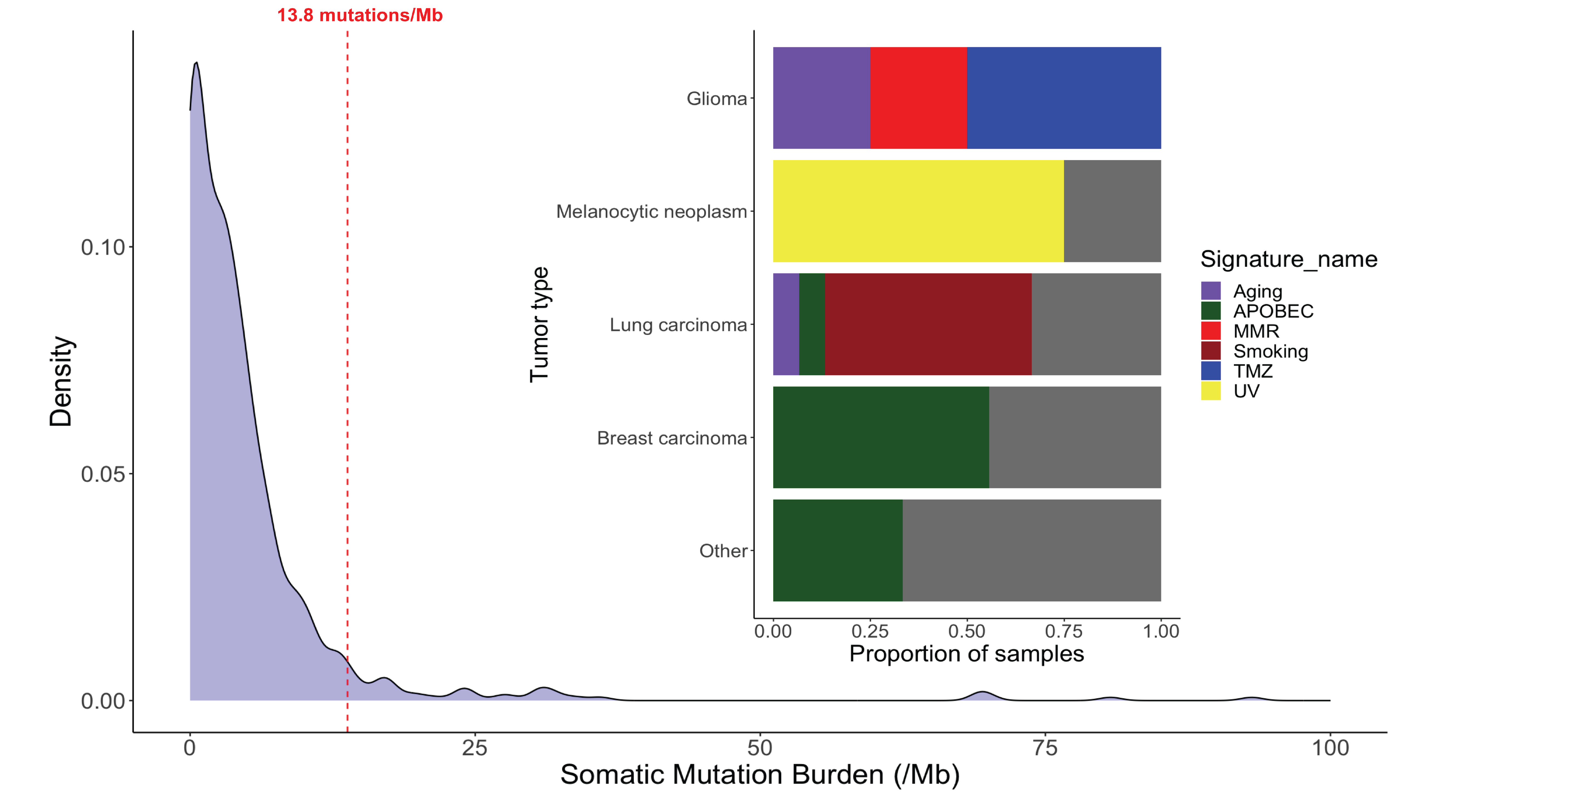

Slide 23
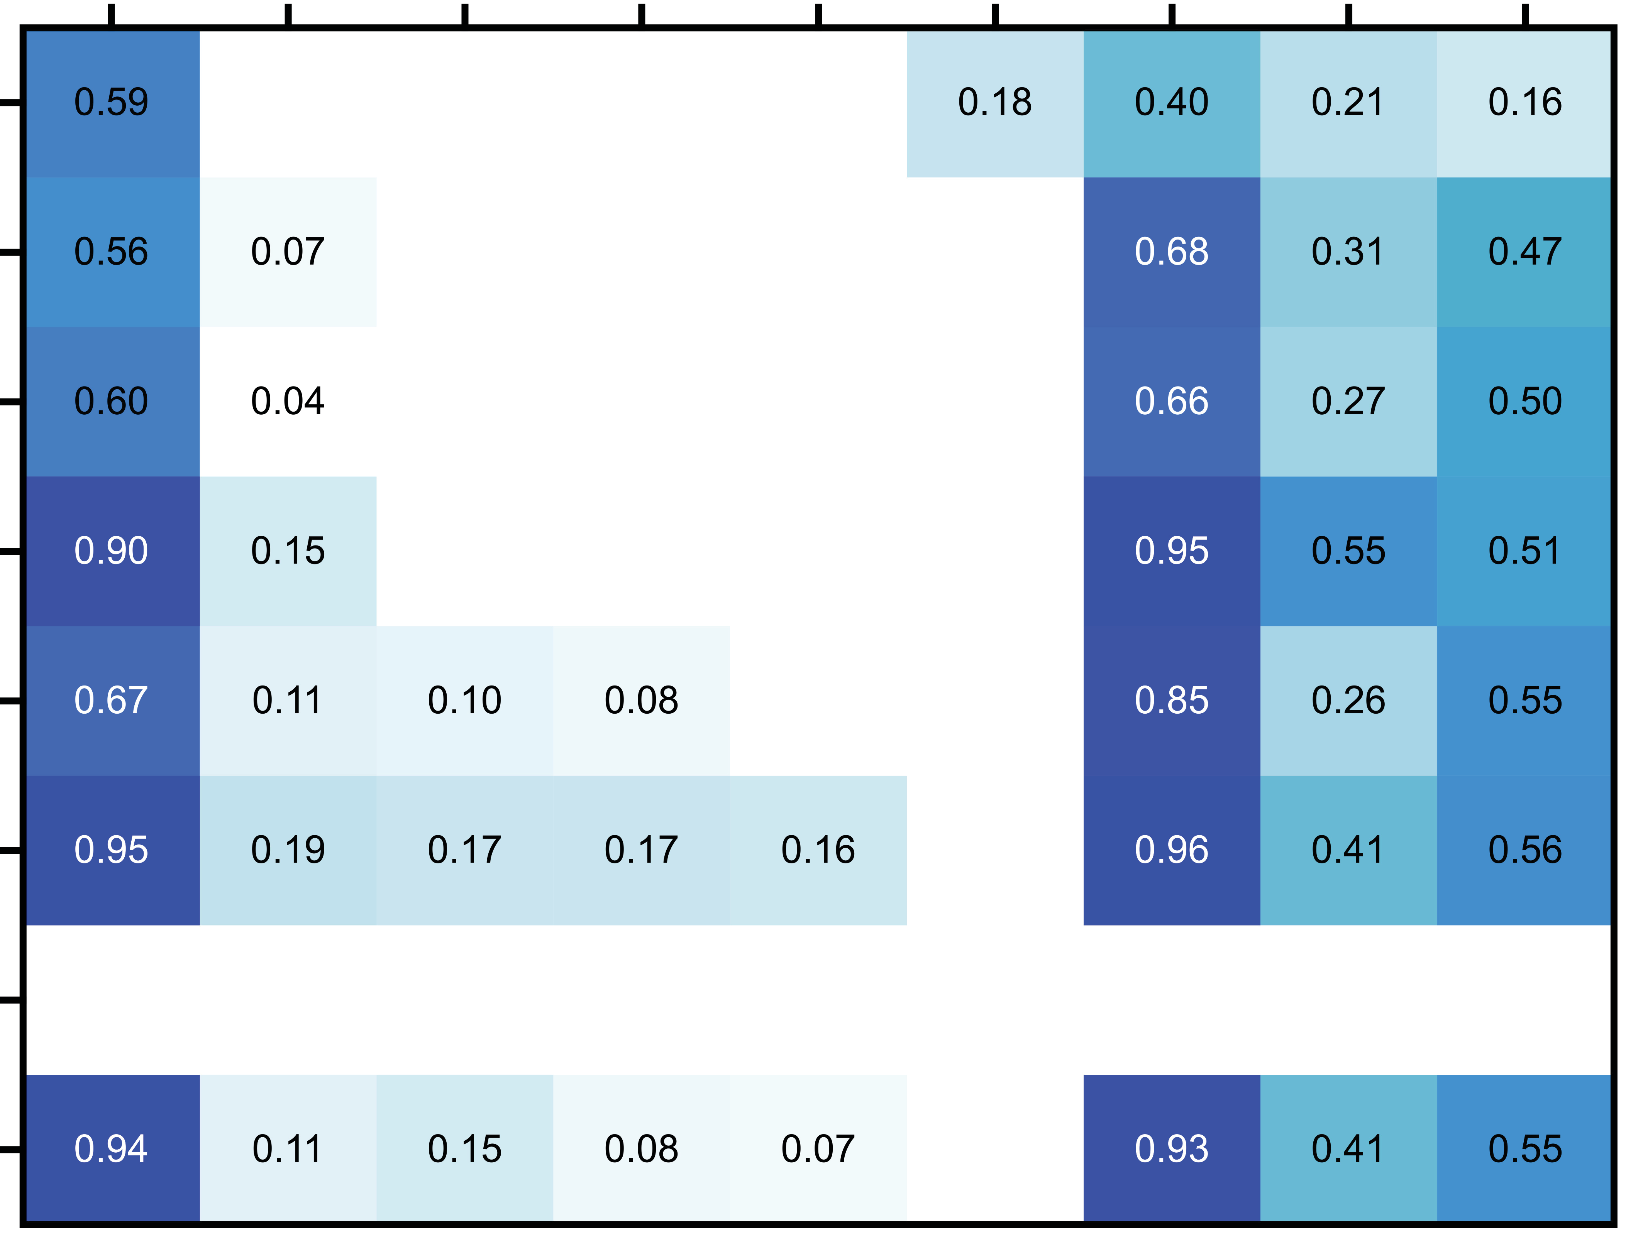
CSF and tissue CSF only
EGFR
L858R
Acquired alterations in EGFR mutated NSCLC
L833V
E746_A750del
E746_S752delinsV
L747_A450delinsP
T790M
G719A
G719C
L792H
S768I
S752_I759del
L747_P753delins(V)S
L718V/Q
L861Q
G719S
PIK3CA
I740_K745dup
KRAS
L747_T751del
BRAF fusion
G12A
G12C
MET
G12V
MET amp
D1010Y
X963_splice
CDK4 amp
RET
X1010_splice
ALK
(Fusion)
ROS
(Fusion)
EGFR amp
ERBB2
(Fusion)
Y772_A775dup
0
5 10 15
Number of alterations
20
(AMP)
G776delinsVC
EGFR
p.L858R
EGFR
p.T790M
EGFR p.L718V
EGFR p.L718Q
EPHB1
p.D864G
EGFR p.V834L
RBM10 P400*
EPHA3 p.I443V
TERT p.D637N
Leptomeningeal involvement Erlotinib start
Switched to Osimertinib
Tumor (resection)
CSF 1
Active monitoring of resistance mechanisms
CSF 2
CSF 3
Resistance to Osimertinib
Proton beam cranio-spinal irradiation
CSF 4
CSF 5
CSF 6
CSF 7
VAF
1.0
0.8
0.6
0.4
0.2
1
1
4
1
R1
R2
R1

Slide 24
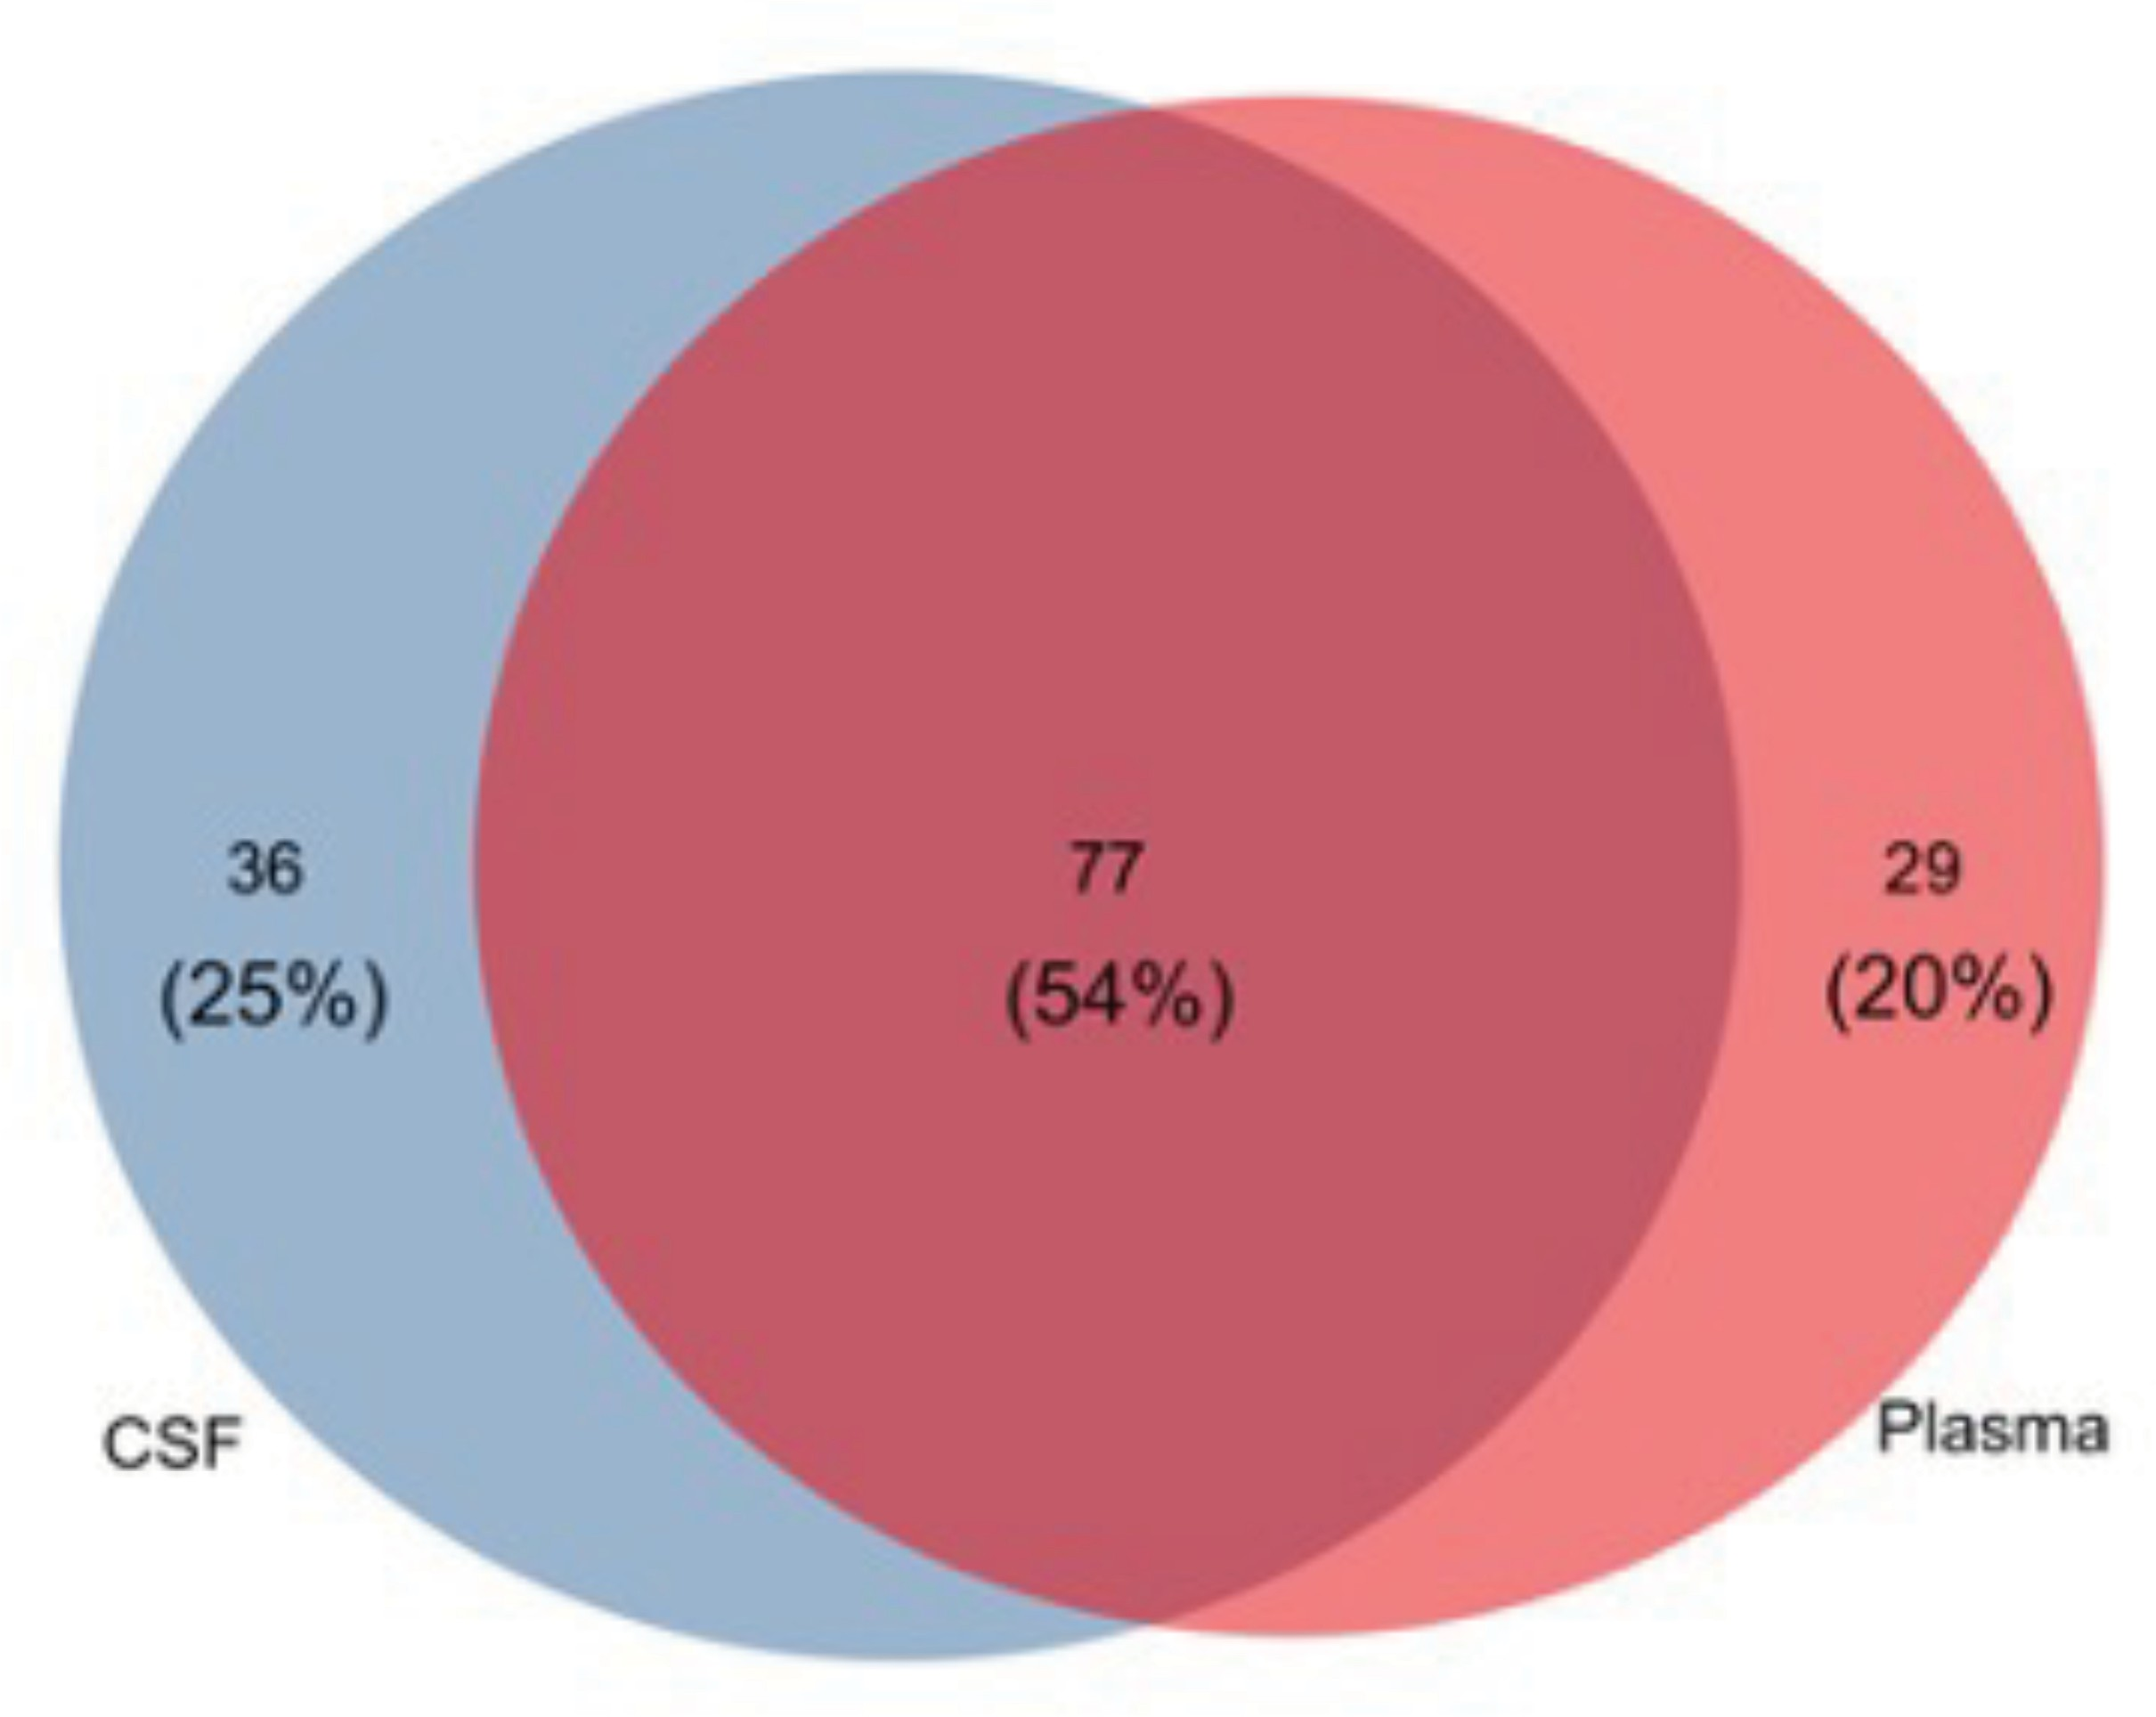
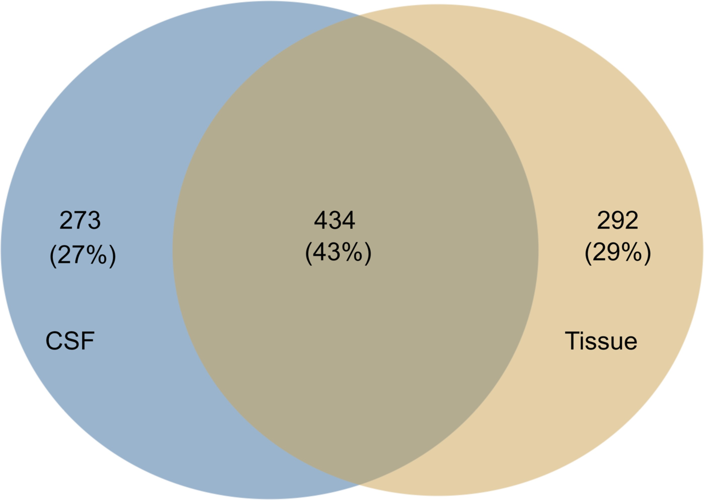
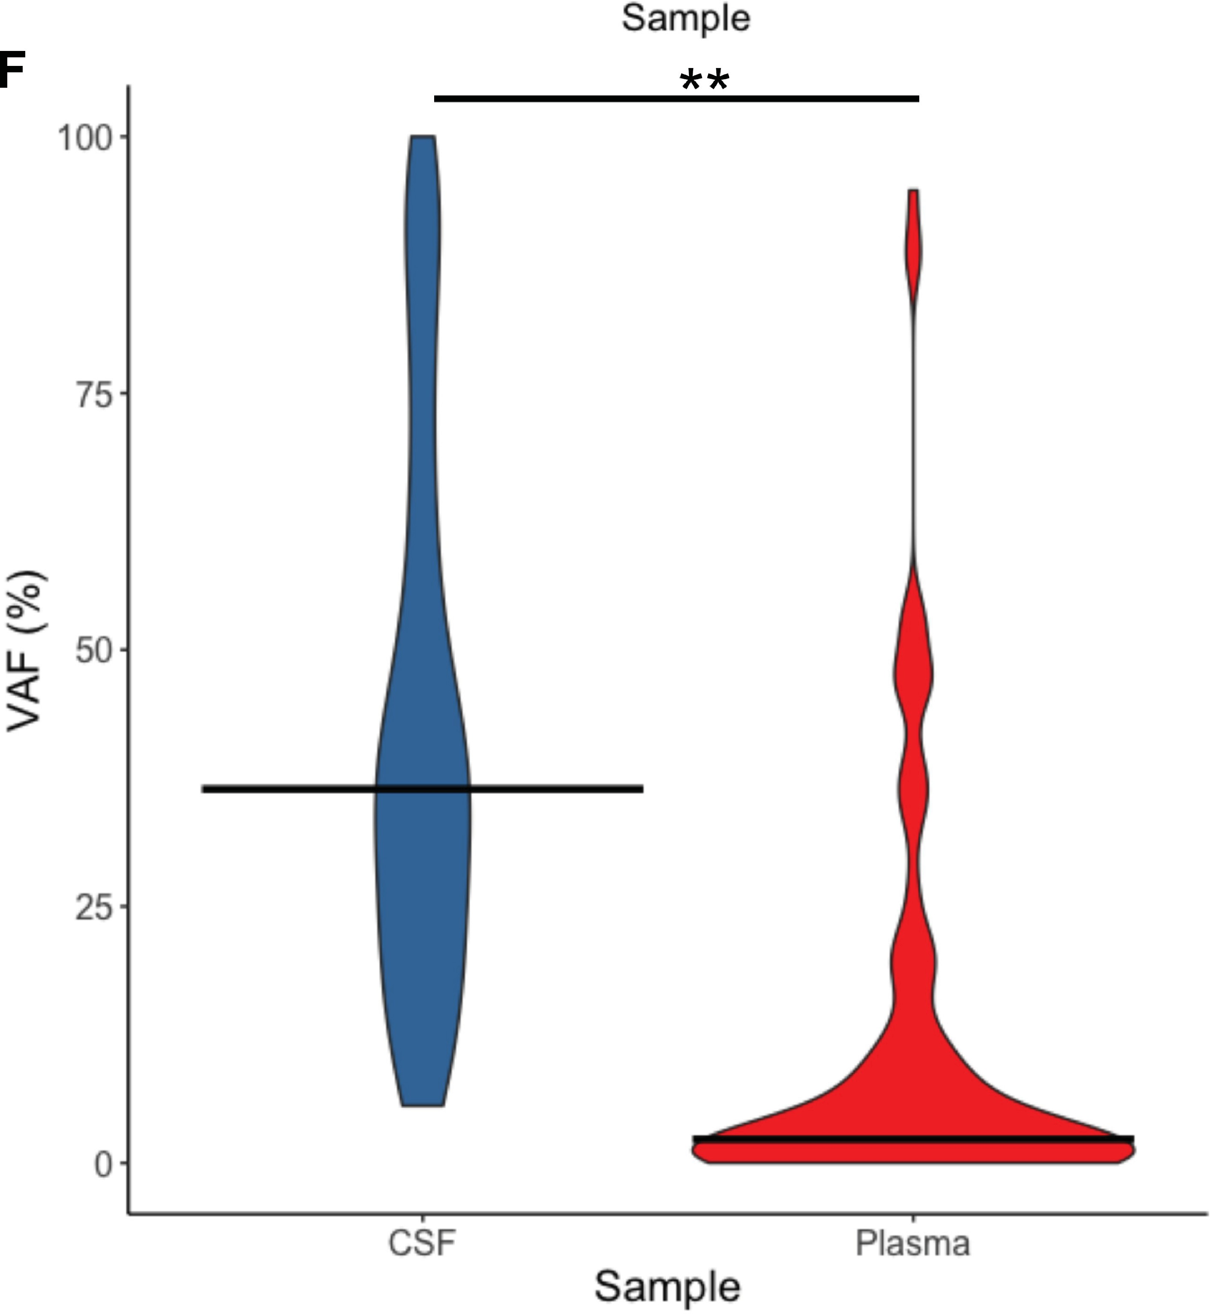
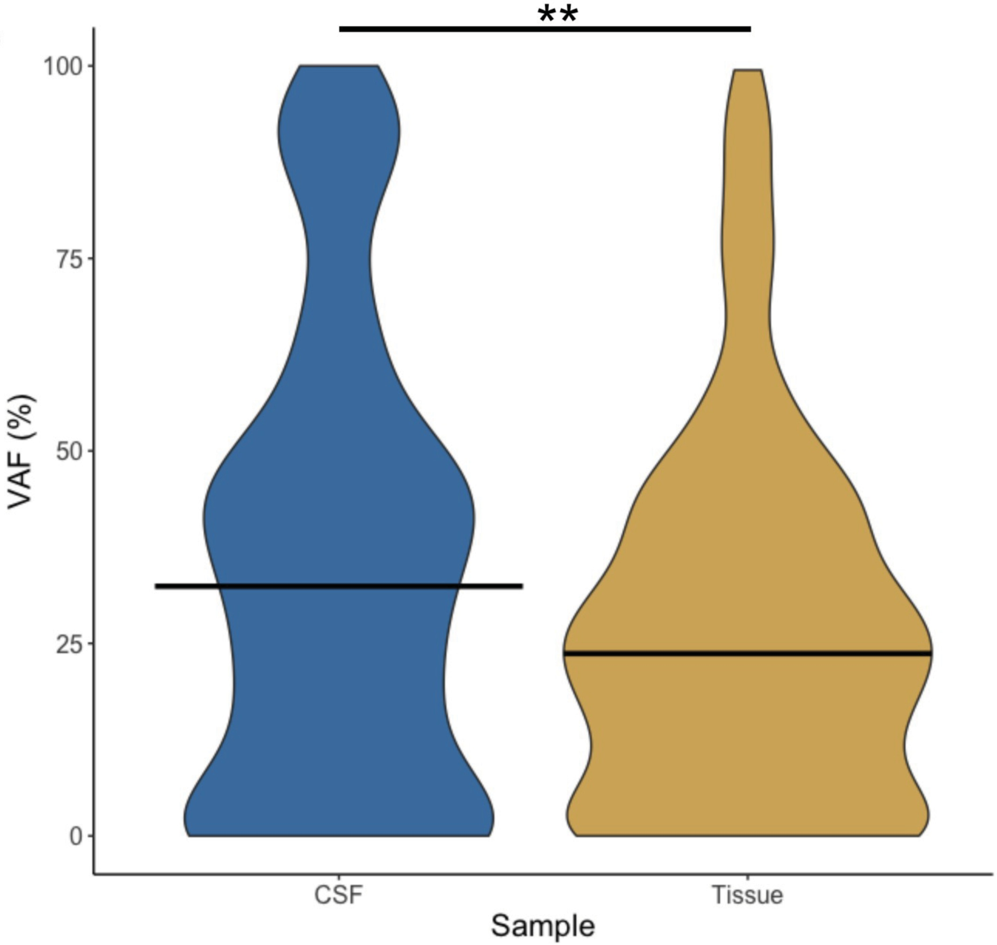
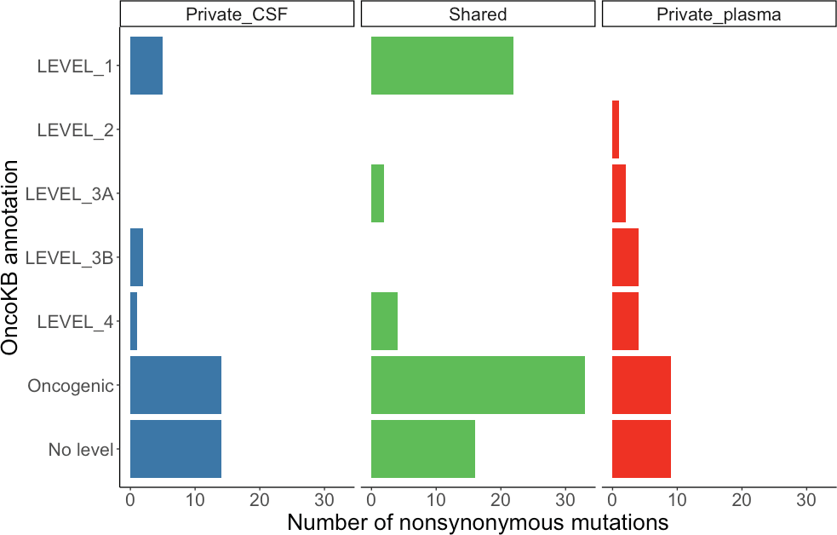
CSF vs Plasma- mets
CSF vs tissue
n=56 pairs, 999 genetic alterations
C

Slide 25
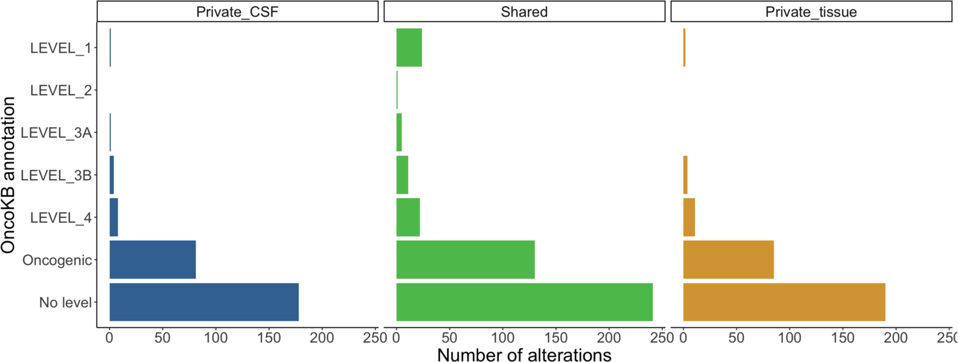
CSF vs Plasma- metastasis
CSF vs tissue

Slide 26
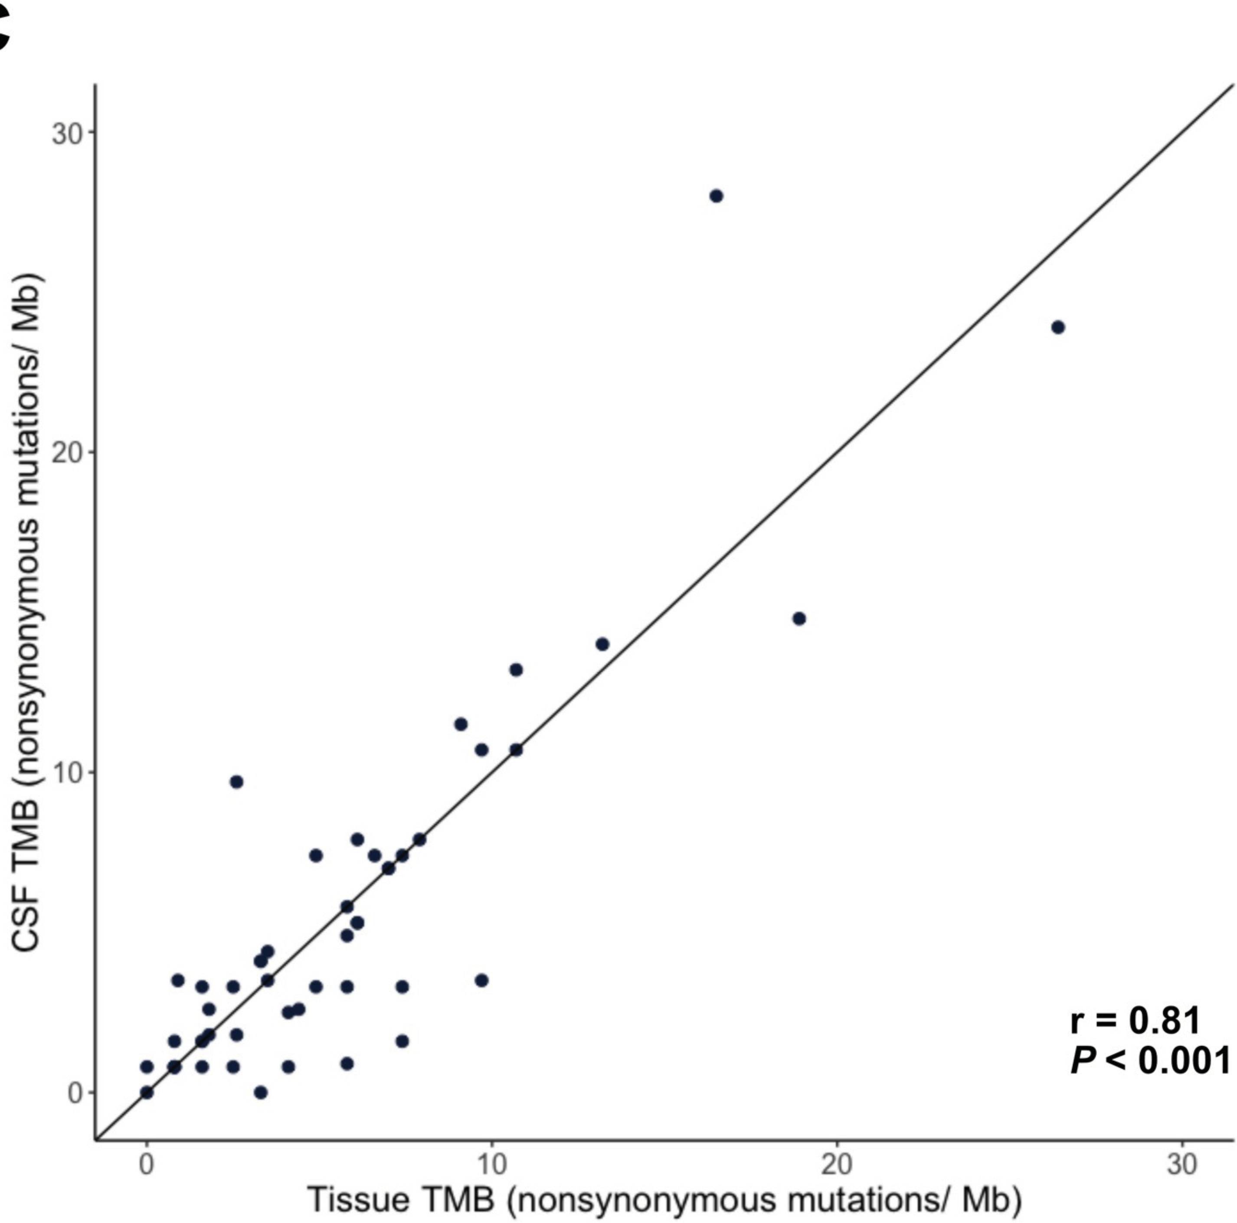
Comparisons of tumor mutation burden of tissue vs CSF cfDNA

Slide 27
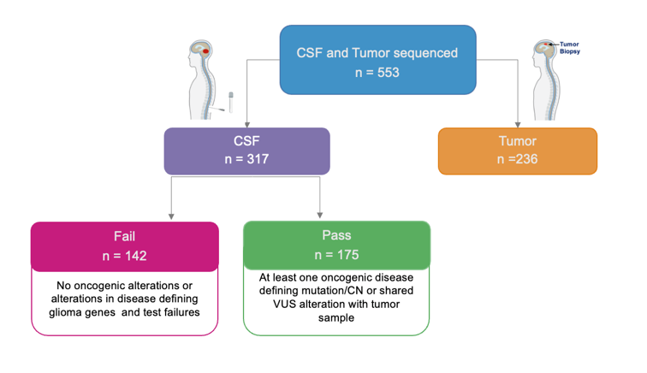
Gliomas
Undetectable tumor DNA
Slide provided by Dr. Alexandra Miller
Notes:
As far as primary brain tumors, this is an important component of the assessment of gliomas. At this time we have sequenced about 550 tumors with corresponding CSF,s. Importantly – across CSF samples many of these samples have low coverage – low grade gliomas may not shed sufficient dNA for diagnosis and oncogenic alterations may not be detected – however, general finding is that for many of these tumors is that the coverage is often very low – suggesting these tumors do not shed as much as metastatic lesions. However, often the case is that failure of sequencing is related to lack of tumor dnA and low level of disease

Slide 28
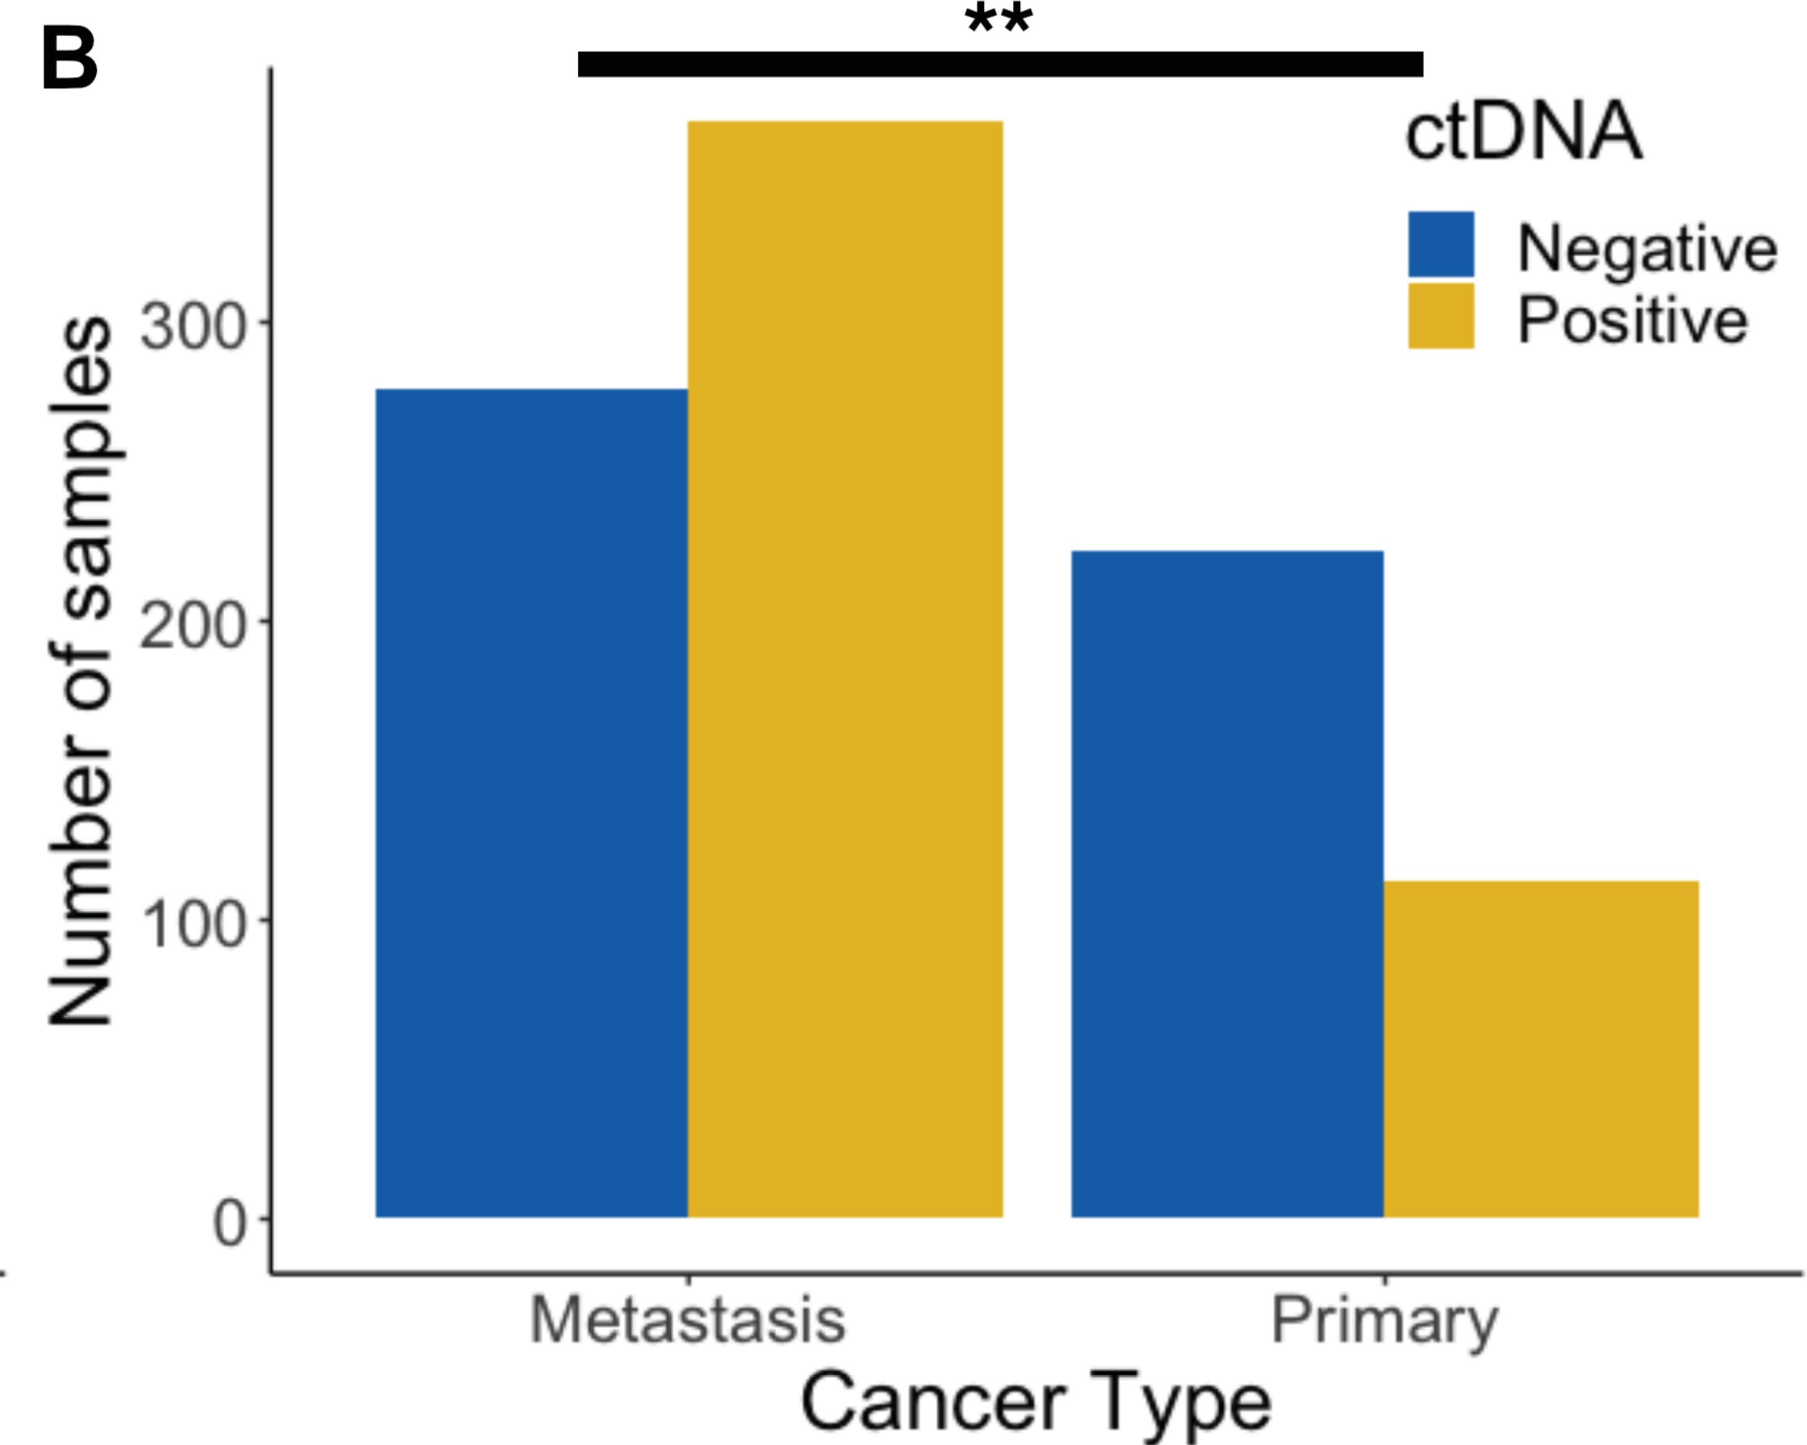
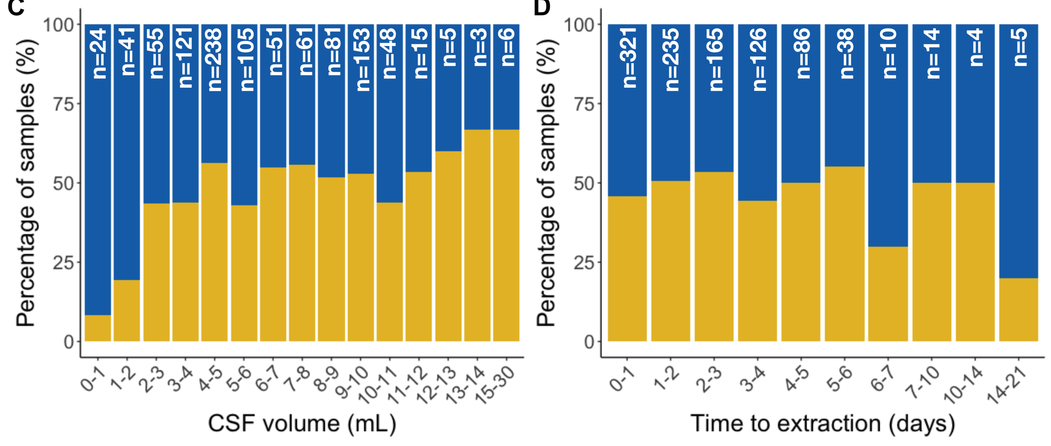
Important pre-analytic considerations
Primary CNS malignancies less likely to have positive in CSF
Volume of CSF matters – only up to one point

Slide 29
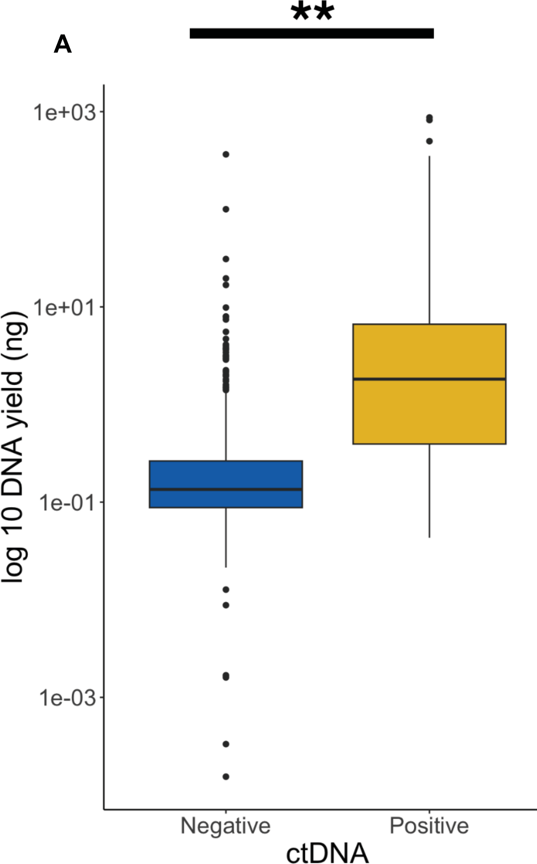
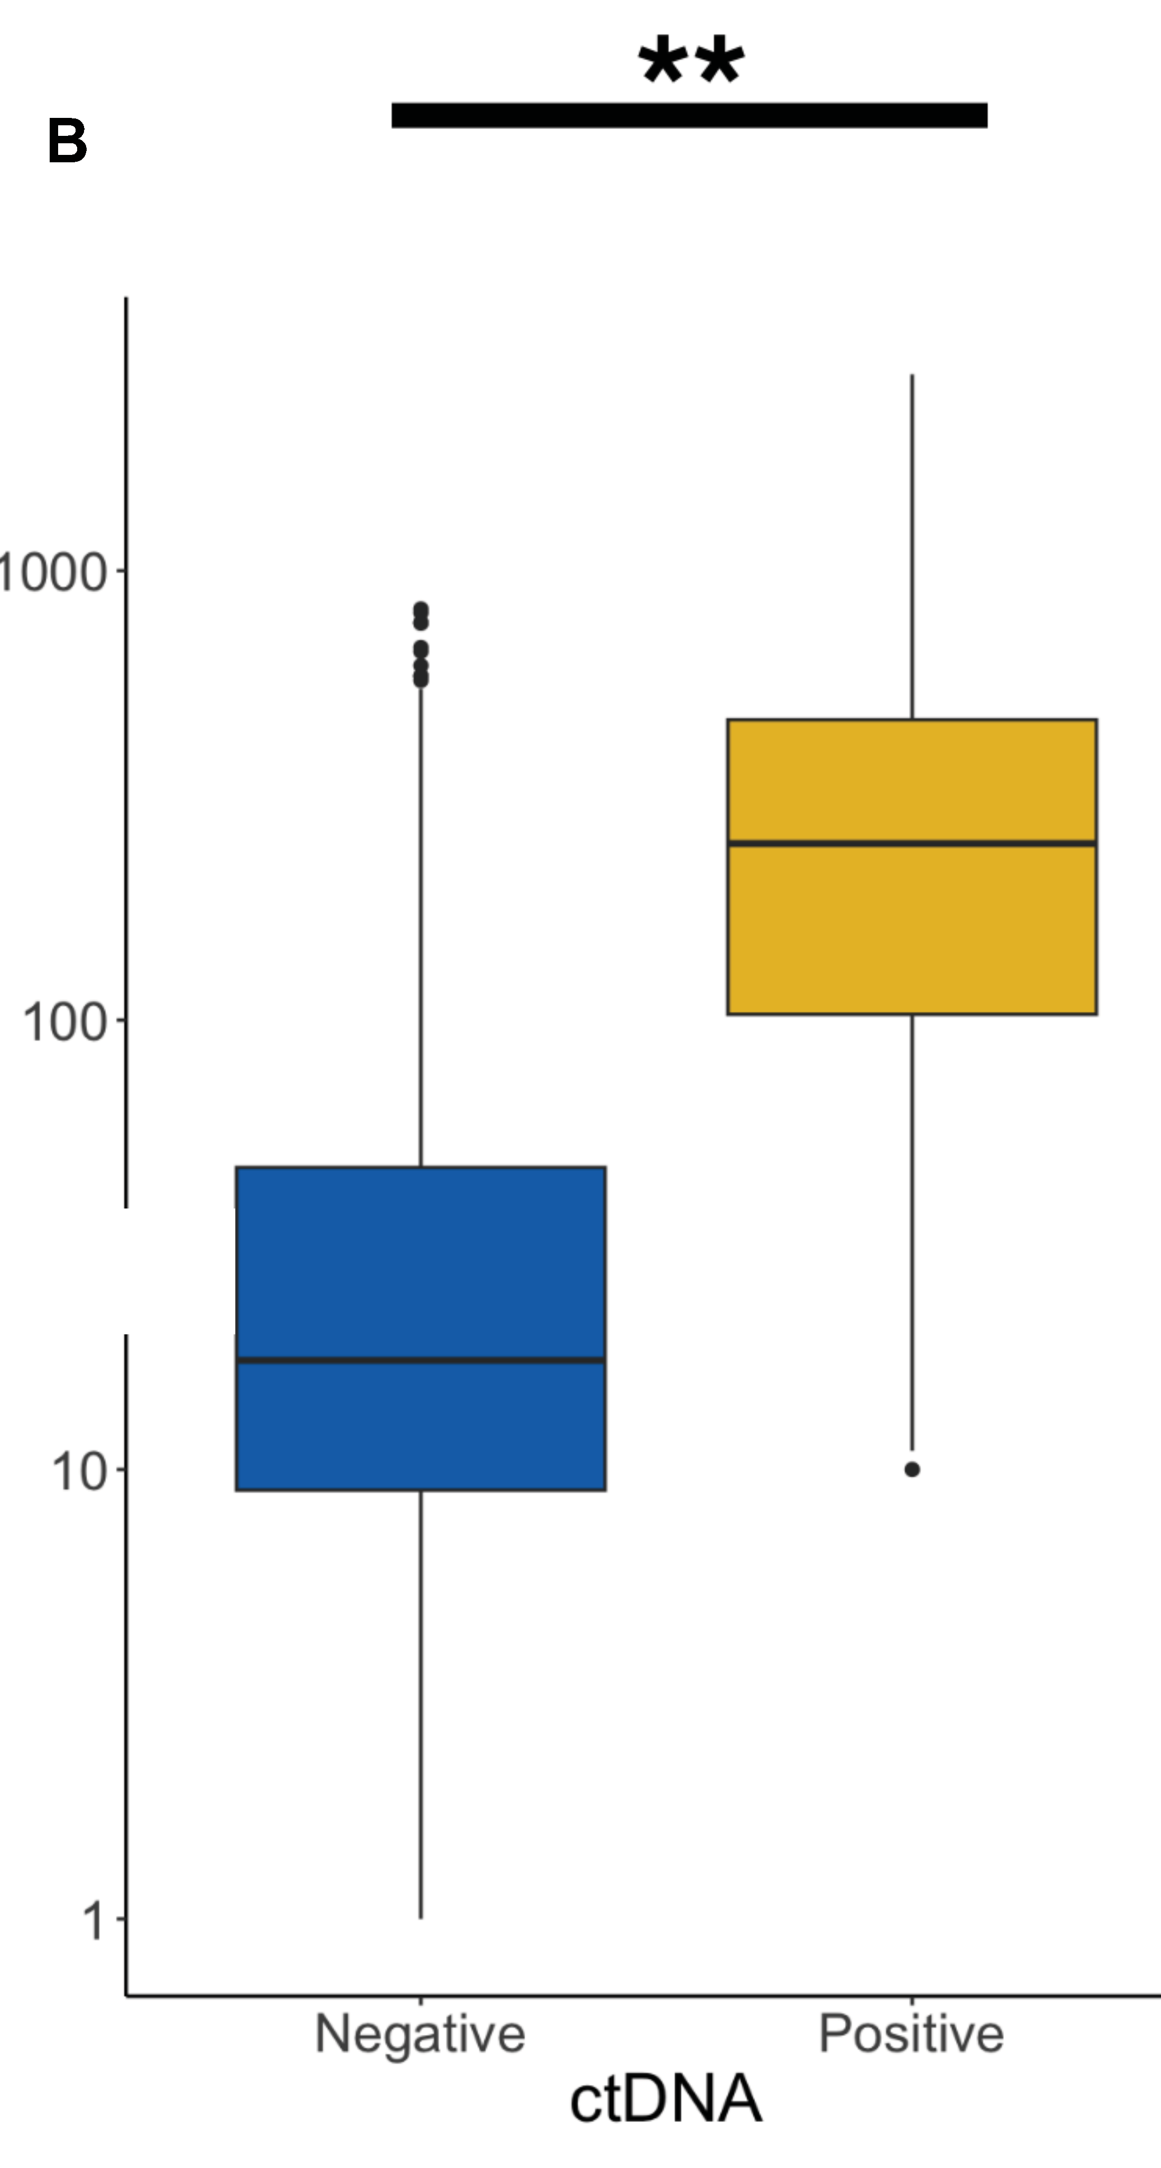
DNA Yield
Sequencing coverage

Slide 30
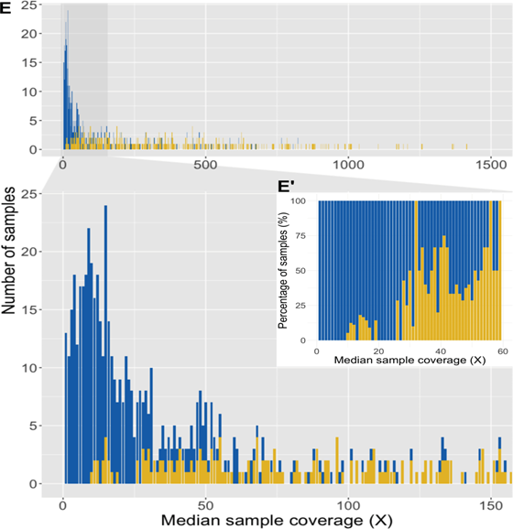

Slide 31
Take Home Points
Rich source of nucleic acid for molecular profiling of CNS tumors - suitable for clinical use
Provides opportunities for diagnosis and active monitoring of patients – to guide clinical management
Intraparenchymal lesions are les likely to be ctDNA positive.
Numerous opportunities for further development of technology to improve comprehensive assessment, enable discovery and further personalize care

